Slide 1
Cryptographic message encoder and decoder
TEAM MEMBERS
CB.SC.U4AIE24106-HARSHA .C
CB.SC.U4AIE24137-PRANEETH .M
CB.SC.U4AIE24145-ROHITH .P
CB.SC.U4AIE24139-SUPREETH .N

Slide 2
Objective
The goal of our project is to encrypt and decrypt messages by creating a hybrid encoder that combines the Affine Cipher and RSA encryption methods to achieve a secure and efficient encryption model.

Slide 3
HOW IT WORKS
The user enters a plaintext message and Affine Cipher keys. So the message is first encrypted by using the Affine Cipher, then further again encrypted with RSA encryption
Then the user receives the encrypted output and a private key for decryption
During decryption, the RSA method is first used to unlock the Affine-encrypted text, which is then processed through the Affine Cipher decryption to fully restore the original message in a readable form.

Slide 4
Affine Cipher Encryption
For encryption, the user enters a text , and a multiplicative key which is coprime to 26 and an additive key.
The algorithm replaces each letter using a mathematical formula
For decryption, the user provides the keys to get back the original message.
THE MATHEMATICAL PROCESS(the affine cipher is based on modular arithmetic)
E(x)=(ax+b)mod26 [for encryption]
D(y)=((a^−1)⋅(y−b))mod26 [ for decryption]
a (multiplicative key) must be coprime to 26 (since there are 26 letters in the English alphabet).
b is an additive key.
X is the position of the letter in the alphabet(0 to 25)
Y is the encrypted character number
a^-1 is the modular inverse of a modulo 26
Finally we get a different number for every character of the original word and based on these numbers obtained we get a encrypted word

Slide 5
RSA Encryption
The RSA takes the word which is encrypted from Affine cipher as the input word
It selects two prime numbers p and q. and computes it product which is n . ->[n=p x q].
Then for Euler’s totient function ϕ(n)=(p-1) x (q-1).
Chooses an encryption exponent e which is coprime to ϕ(n)
Where e is the value between 1 and ϕ(n) and it satisfy G.C.D (ϕ(n),e)=1
Then it computes the modular inverse d(decryption key ),satisfying ; e.d ≡ 1 modϕ(n)
it gives public key (e , n) for encryption and private key(d , n) for decryption
Encryption process ::
It converts the character into its ASCII value and applies the formula: C=P^e mod n
P=plaintext character’s ASCII value and C= encrypted numerical value
Decryption process ::
It takes each encrypted value c and decrypts it using P=C^d mod n
Then converts the decrypted ASCII values back to characters.

Slide 6
Why our hybrid model is better
Optimized Performance – RSA requires a lot of computing power for large data. Pre-encrypting with Affine Cipher reduces computational load while maintaining security
Layered Protection – Combining symmetric (Affine) and asymmetric (RSA) encryption adds multiple layers of defense against attacks.
Balanced Performance – The hybrid model maintains a balance between speed and security, making it efficient for real-world applications.

Slide 7
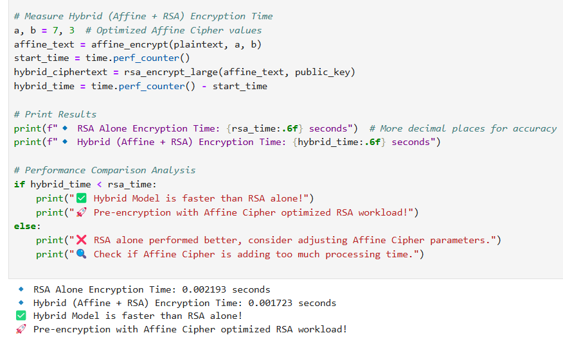
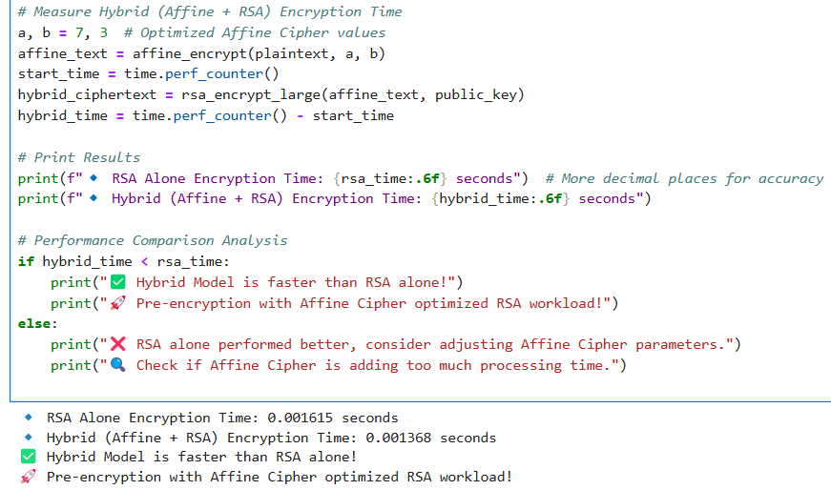
How our model is more efficient and reduces RSA load
For normal small and medium length sentences both RSA and hybrid model works as same but when it comes for large length sentences the hybrid model works more efficient and fast.
The affine cipher first make the encrypted text in structural and predictable way for the RSA encryption which reduces the workload for RSA encryption rather than direct RSA encryption
The results we got while running both hybrid model and RSA model for optimized performance.

Slide 8
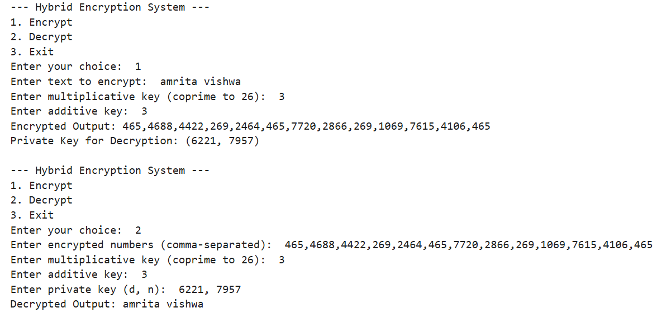
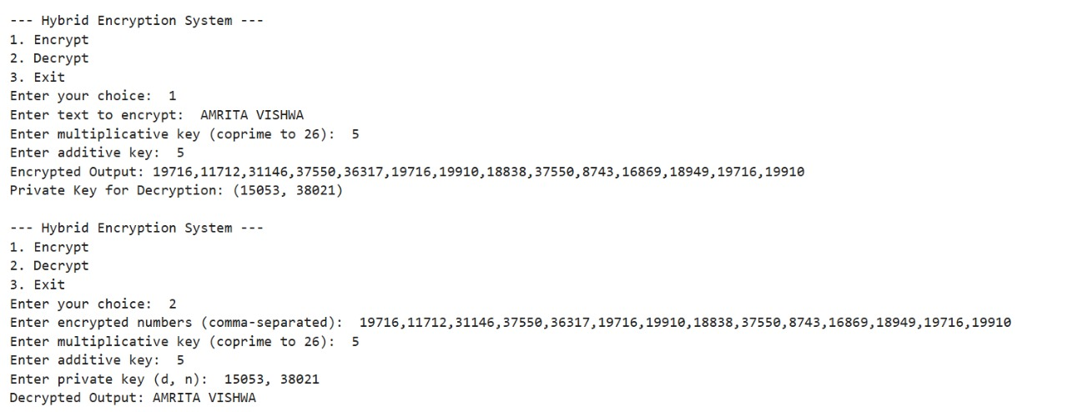
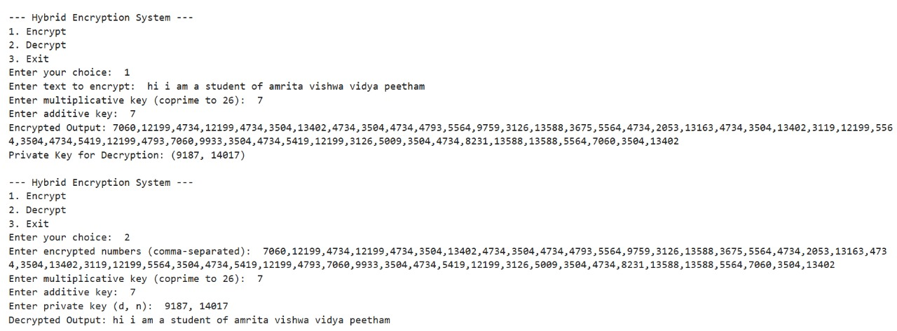
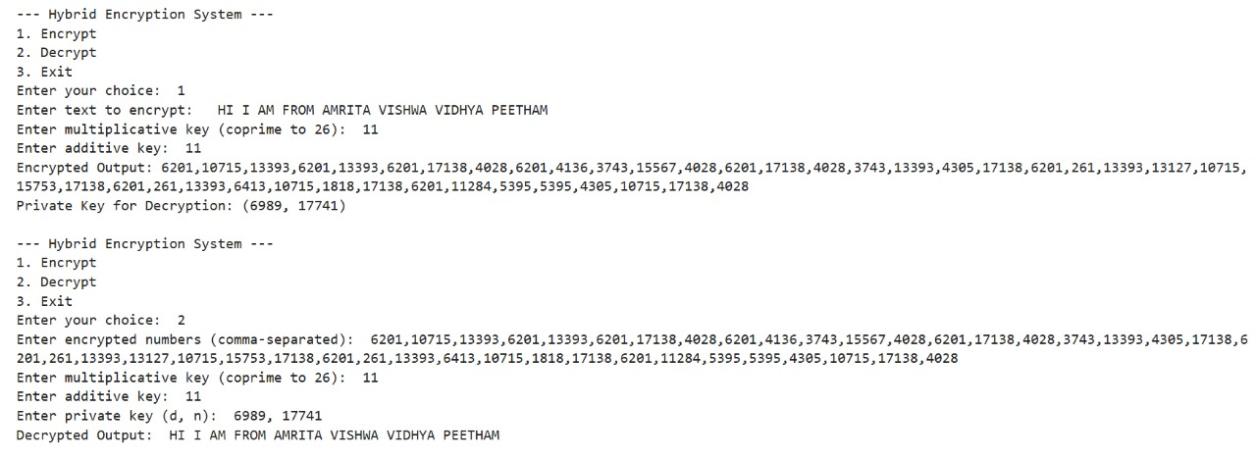
RESULTS of encrypting and decrypting of hybrid model

Slide 9
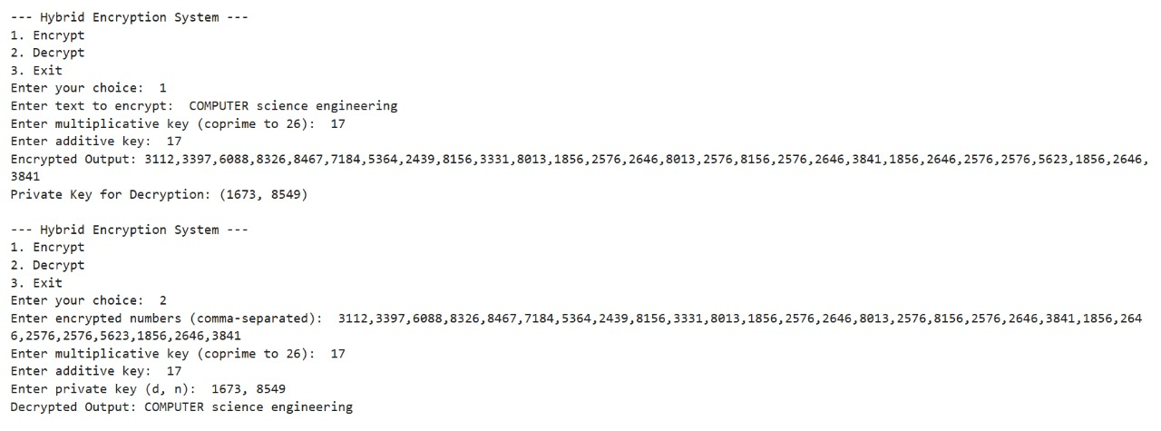
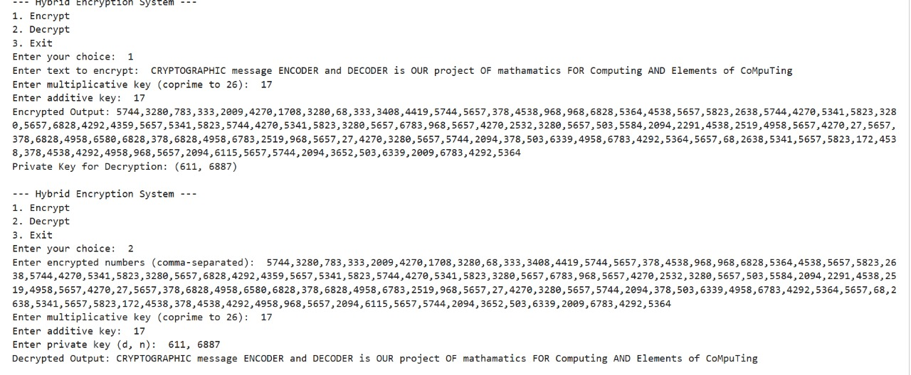
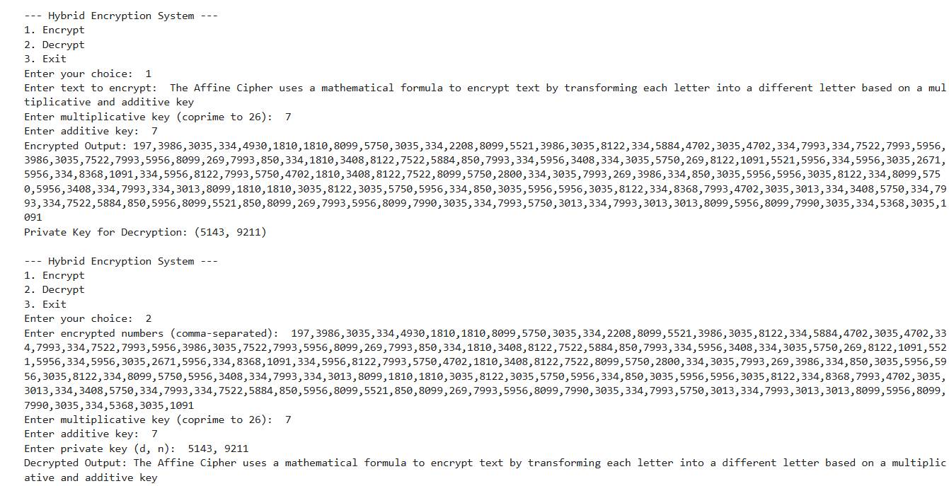
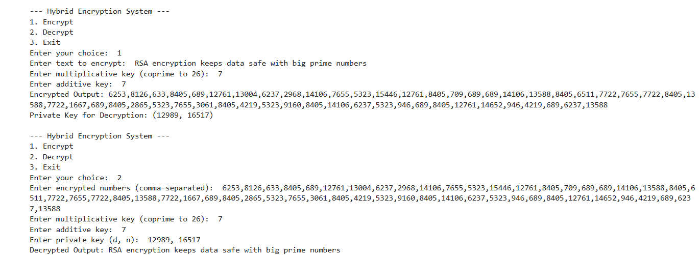

Slide 10
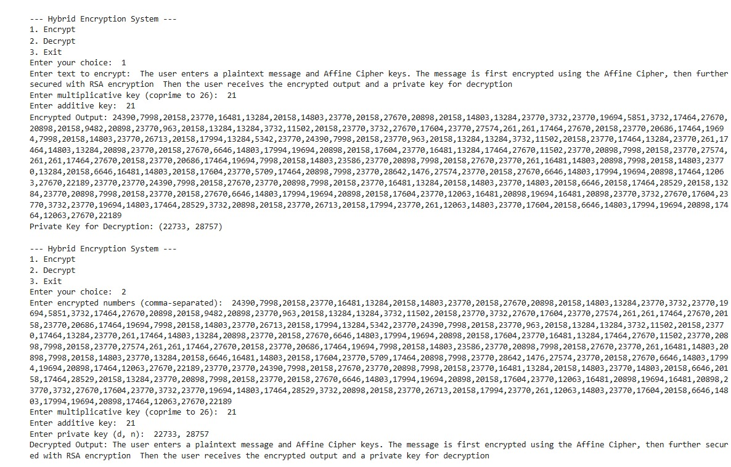
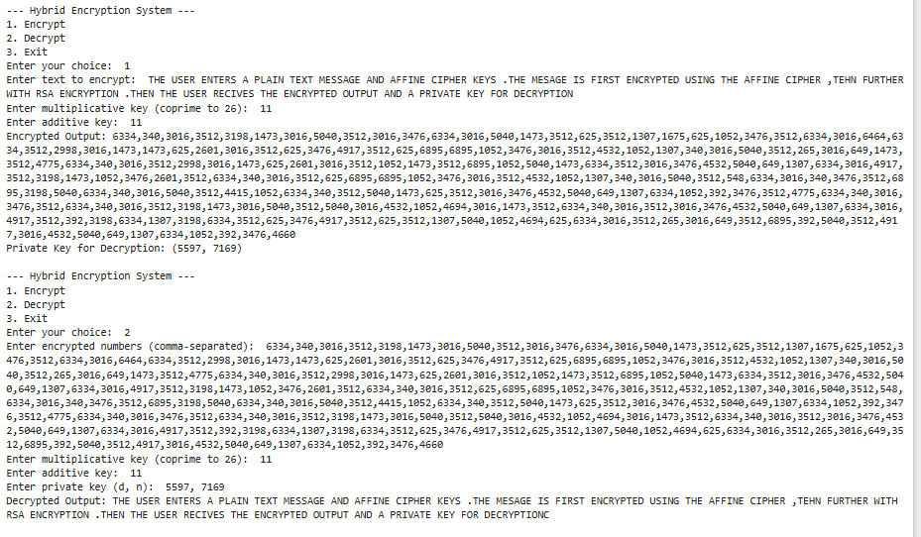
We tested our model with different sentence of size small, medium, and large using both uppercase and lowercase letters . In every case, the model successfully decrypted the text correctly, achieving 100% accuracy.
For future implementation we need train our model for encrypting and decrypting the symbols and numbers

Slide 11
Thank you

